Slide 1
Ansible AWX
Mustafa Mohammed
Amir Mohamed
Hadeer Ali

Slide 2
Ansible AWX
Defination
Diff Between Ansible Tower and AWX
Features
Packages
Demo

Slide 3
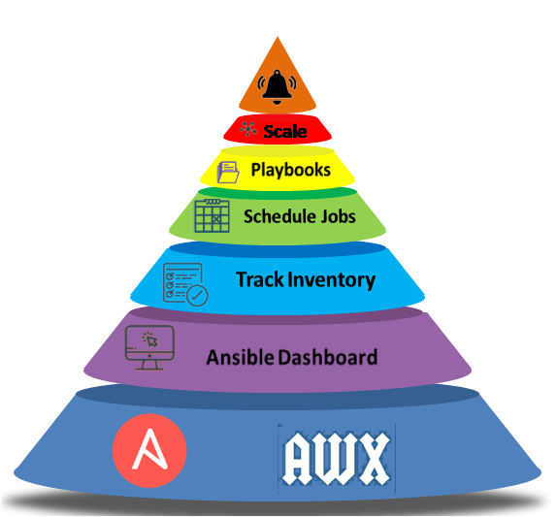
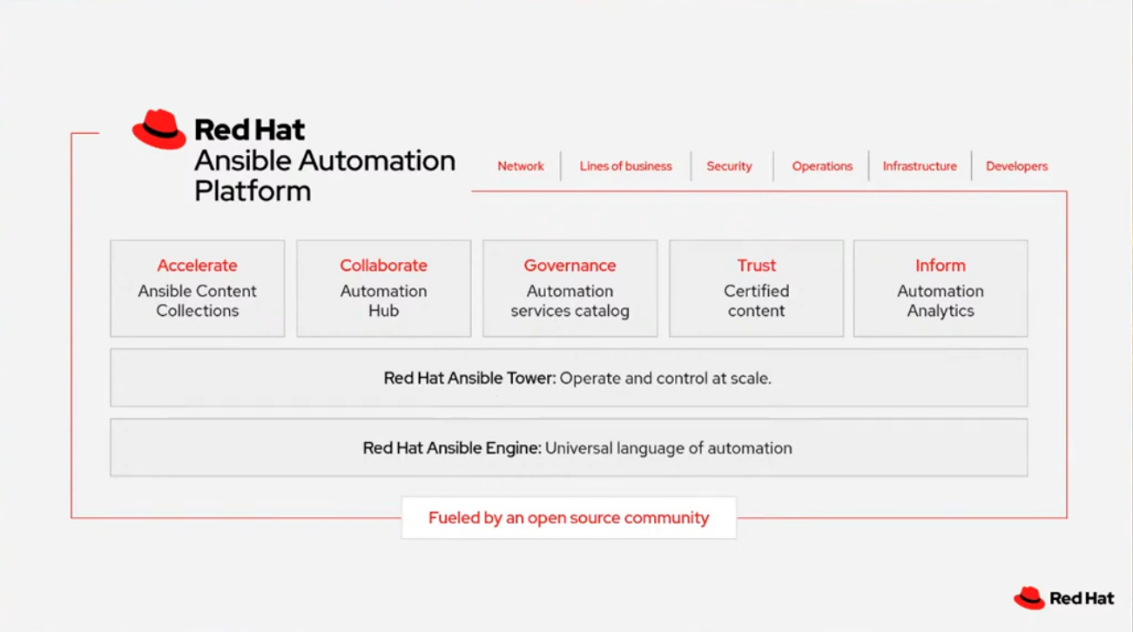
Ansible Tower OR AWX

Slide 4
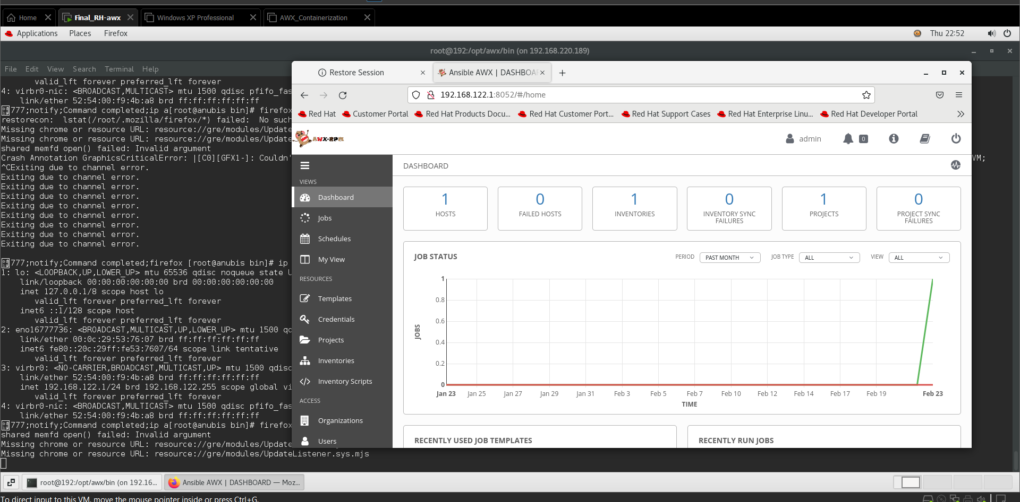
AWX Dashboard

Slide 5
Features of Ansible Tower
Credentials
Project
Job Templetes
Work flows
Enterprise Authentication
Restful API
Centerlized Logging
RBAC
Self-Service IT

Slide 6
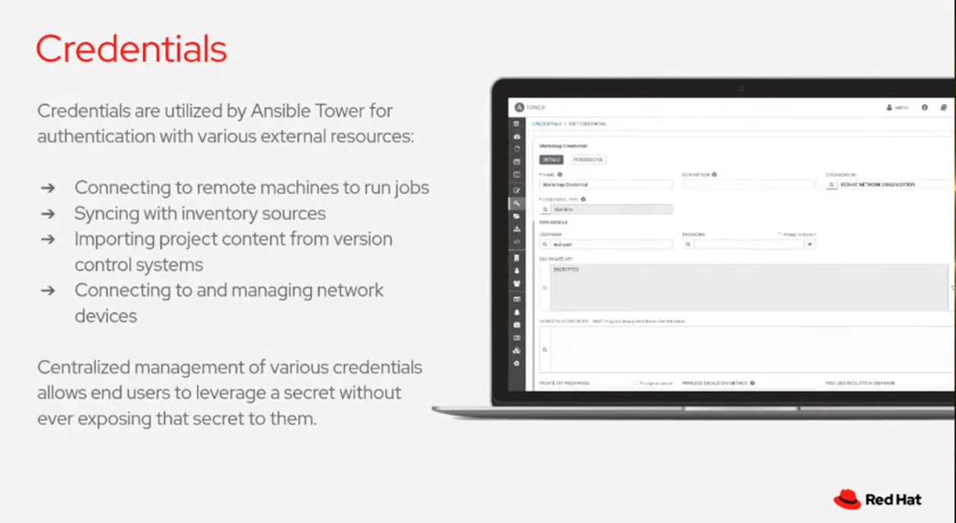
Features of Ansible Tower(cont..)

Slide 7
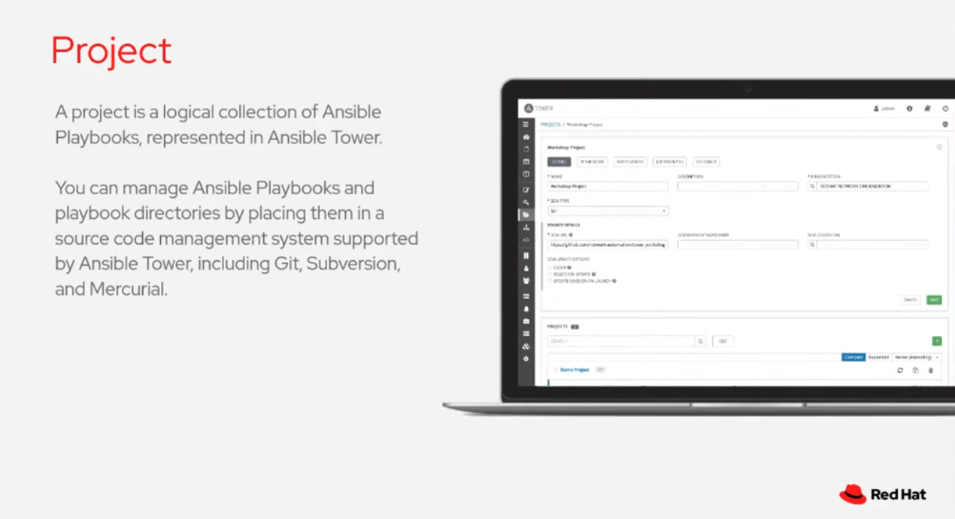
Features of Ansible Tower(cont..)

Slide 8
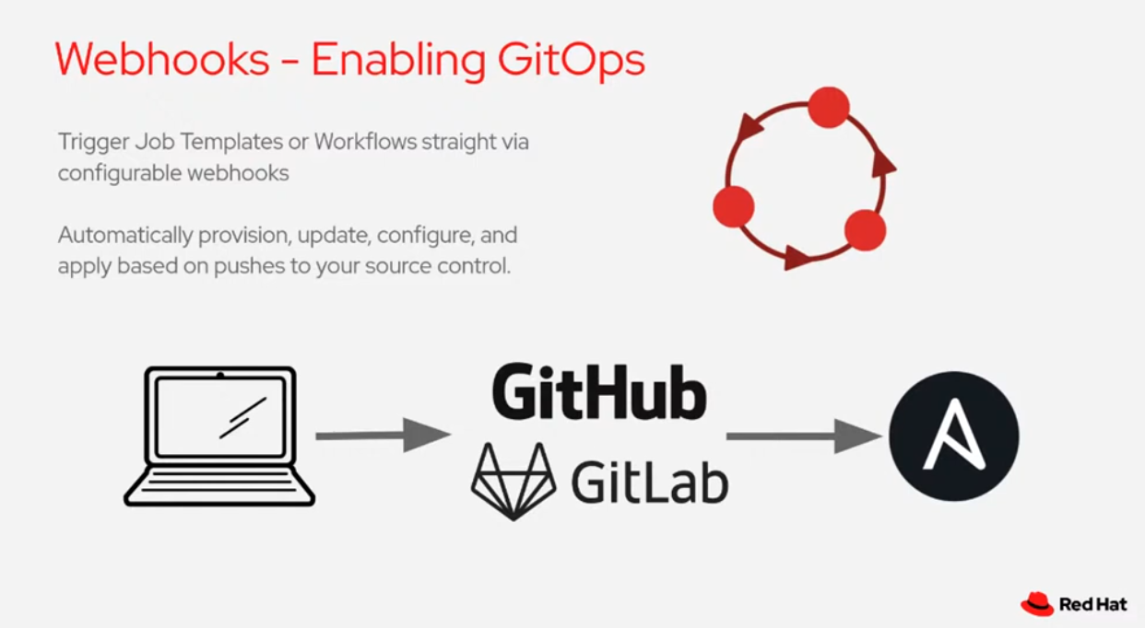
Features of Ansible Tower(cont..)
Project

Slide 9
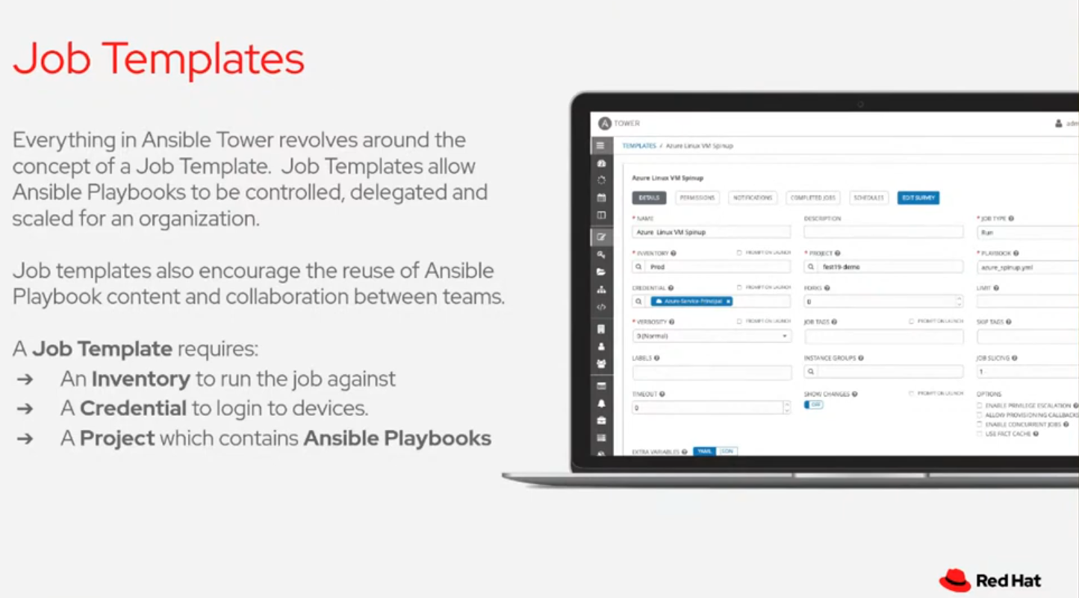
Features of Ansible Tower(cont..)

Slide 10
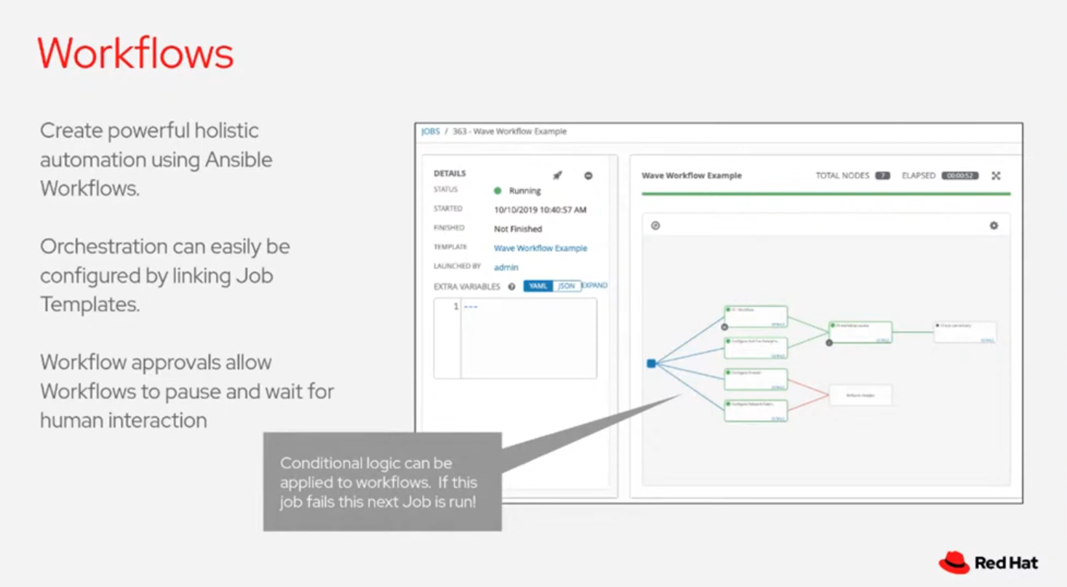
Features of Ansible Tower(cont..)

Slide 11
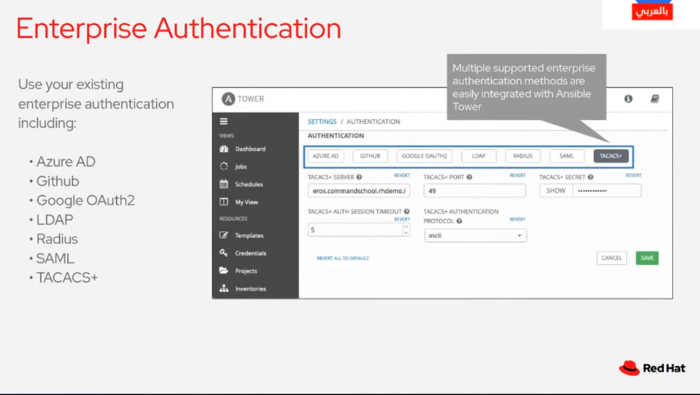
Features of Ansible Tower(cont..)

Slide 12
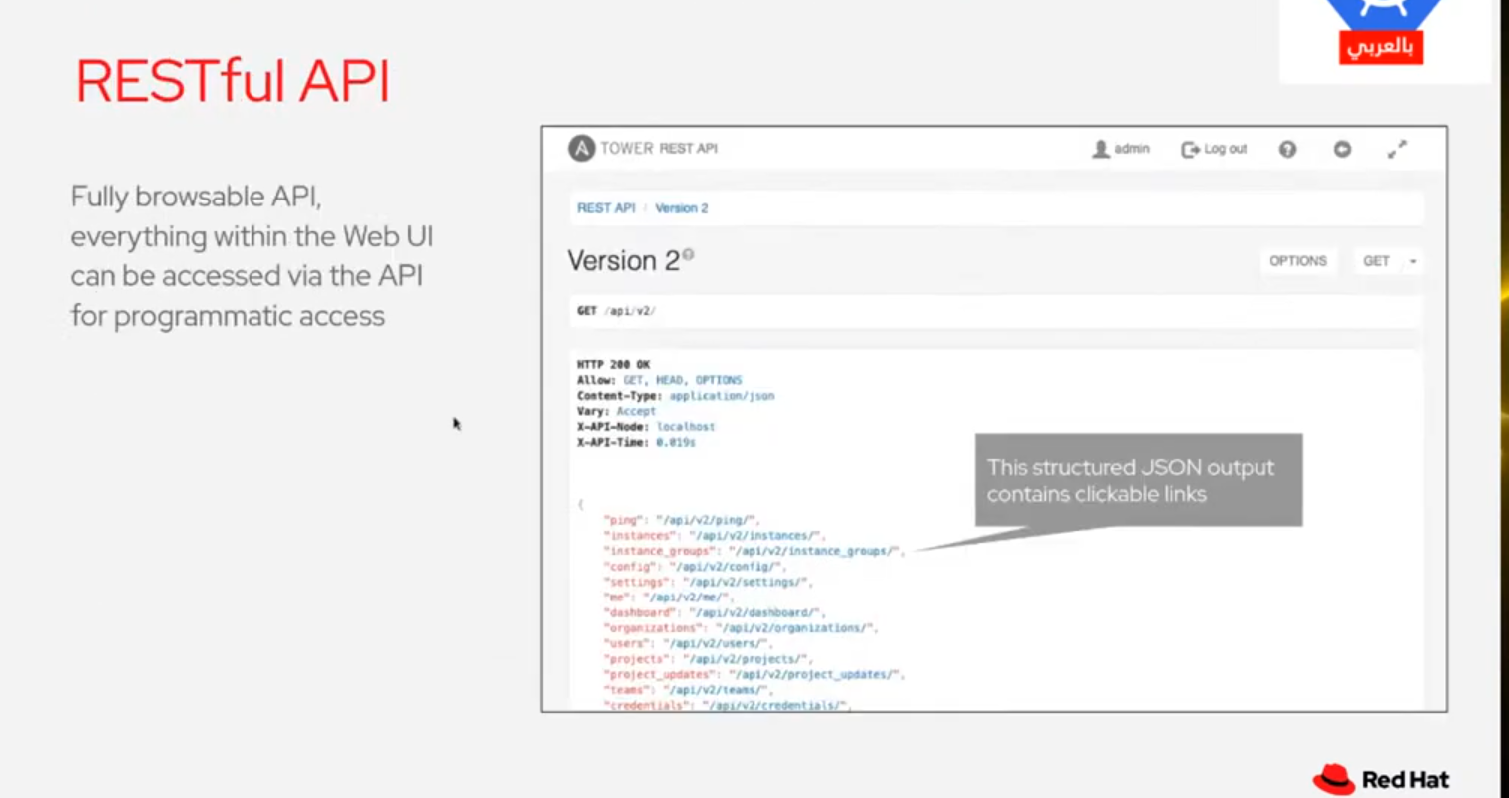
Features of Ansible Tower(cont..)

Slide 13
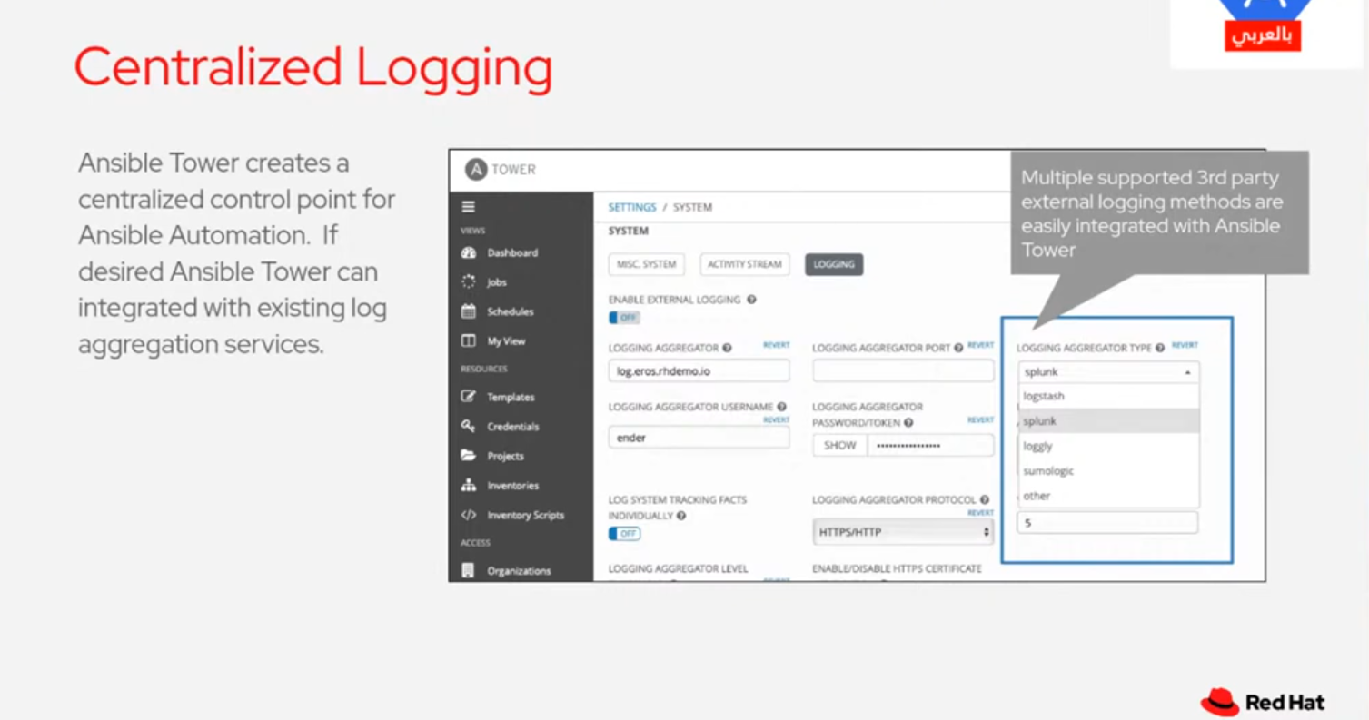
Features of Ansible Tower(cont..)

Slide 14
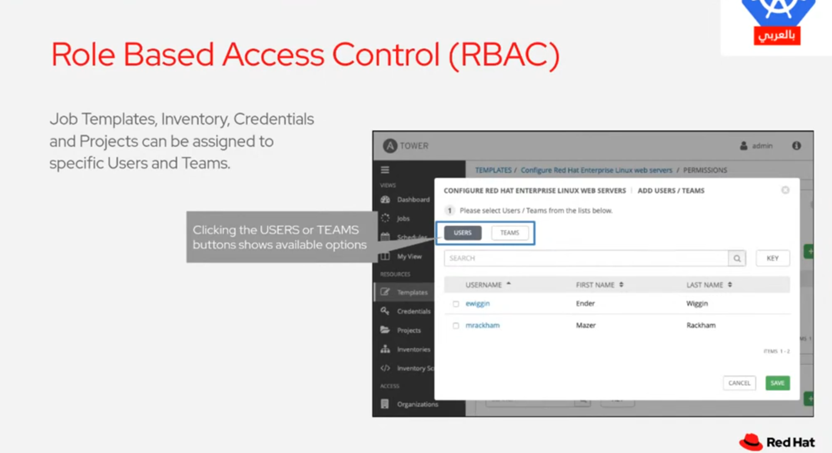
Features of Ansible Tower(cont..)

Slide 15
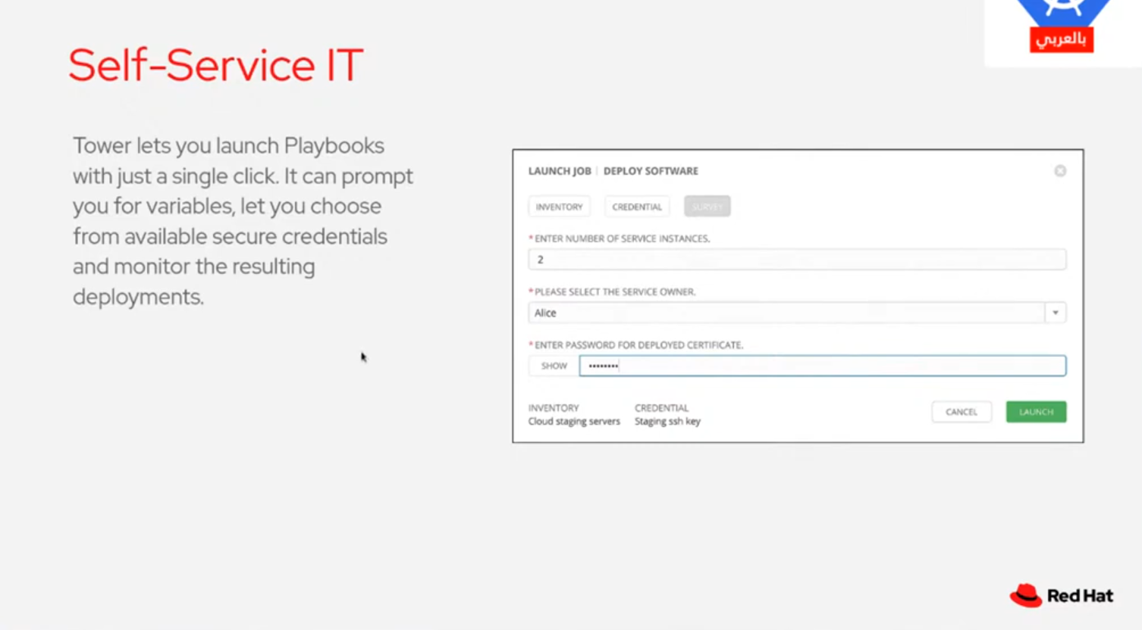
Features of Ansible Tower(cont..)

Slide 16
Packages
rabbitmq-server
rh-postgresql10
memcached
rh-python36
rh-git29
Nginx
ansible-awx

Slide 17
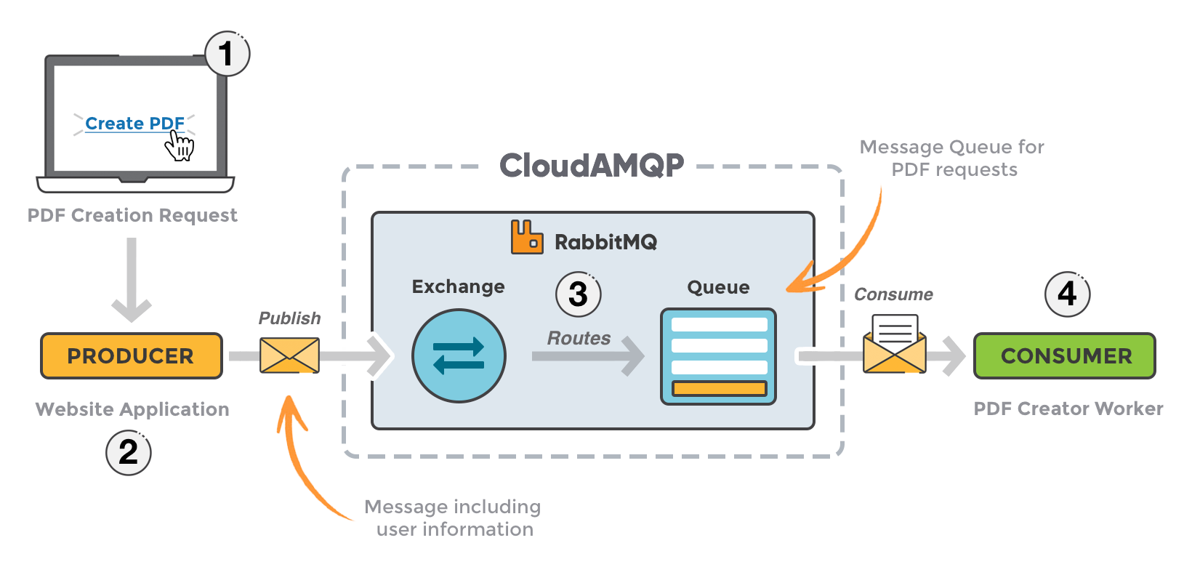
Packages (cont..)
rabbitmq-server: messaging broker widely used to get quick responses from web servers instead of performing resource-intensive operations

Slide 18
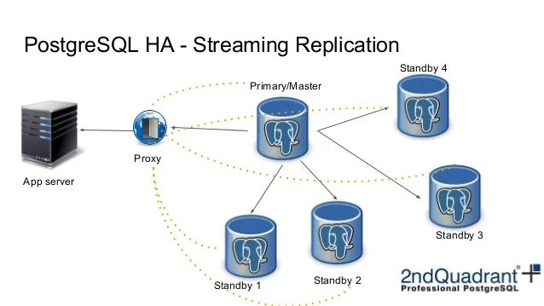
Packages (cont..)
rh-postgresql10:

Slide 19
Packages (cont..)
Memcached
general-purpose distributed memory-caching system. It is often used to speed up dynamic database-driven websites by caching data and objects in RAM Using the tcp/ip protocols to establish
high-performance caching system that was developed by Danga Interactive

Slide 20
Packages (cont..)
rh-python36: Software Collection contains Python 3.6 interpreter, a set of extension libraries useful for programming web applications and mod_wsgi
Install the Collection : # yum install rh-python36
Start Using Software Collections : # scl enable rh-python36 bash

Slide 21
Packages (cont..)
rh-git29
A release of Git, a distributed revision control system with a decentralized architecture
Git is a fast, scalable, distributed revision control system with an unusually rich command
Install the collection: # yum install rh-git29
Start Using Software Collections : # scl enable rh-git29 bash

Slide 22
Packages (cont..)
Nginx
web server that can also be used as a reverse proxy, load balancer, mail proxy and HTTP cache
Install the Collection : # yum install nginx

Slide 23
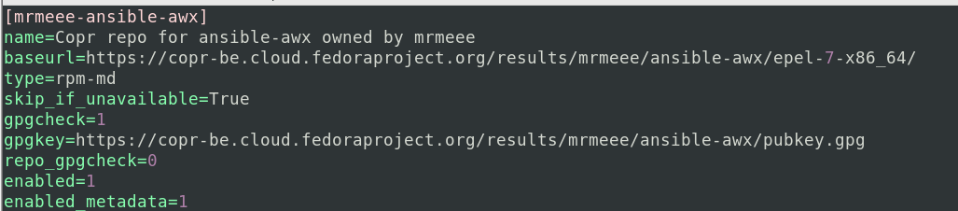
AWX Repository

Slide 24
Initialize services
# cd /opt/awx/bin
# scl enable rh-postgresql10 "postgresql-setup initdb"
# wget -O /etc/nginx/nginx.conf https://raw.githubusercontent.com/MrMEEE/awx-build/master/nginx.conf

Slide 25
Service Managment
systemctl restart memcached
systemctl restart rabbitmq-server
systemctl restart rh-postgresql10-postgresql.service
systemctl restart nginx

Slide 26
Install missing python packages
scl enable rh-python36 bash
pip install --upgrade pip
pip install django==2.2.4
pip install channels==1.1.5
Pip install split_settings

Slide 27
Initialize awx
sudo -u awx scl enable rh-python36 rh-postgresql10 "awx-manage migrate"
echo "from django.contrib.auth.models import User; User.objects.create_superuser('admin', 'root@localhost', 'password')" | sudo -u awx scl enable rh-python36 rh-postgresql10 "awx-manage shell"
sudo -u awx scl enable rh-python36 rh-postgresql10 "awx-manage create_preload_data"
sudo -u awx scl enable rh-python36 rh-postgresql10 "awx-manage provision_instance --hostname=$(hostname)"
sudo -u awx scl enable rh-python36 rh-postgresql10 "awx-manage register_queue --queuename=tower --hostnames=$(hostname)“
systemctl restart awx-cbreceiver awx-dispatcher awx-channels-worker awx-daphne awx-web awx

Slide 28
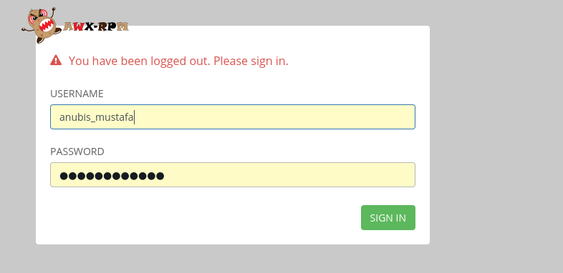
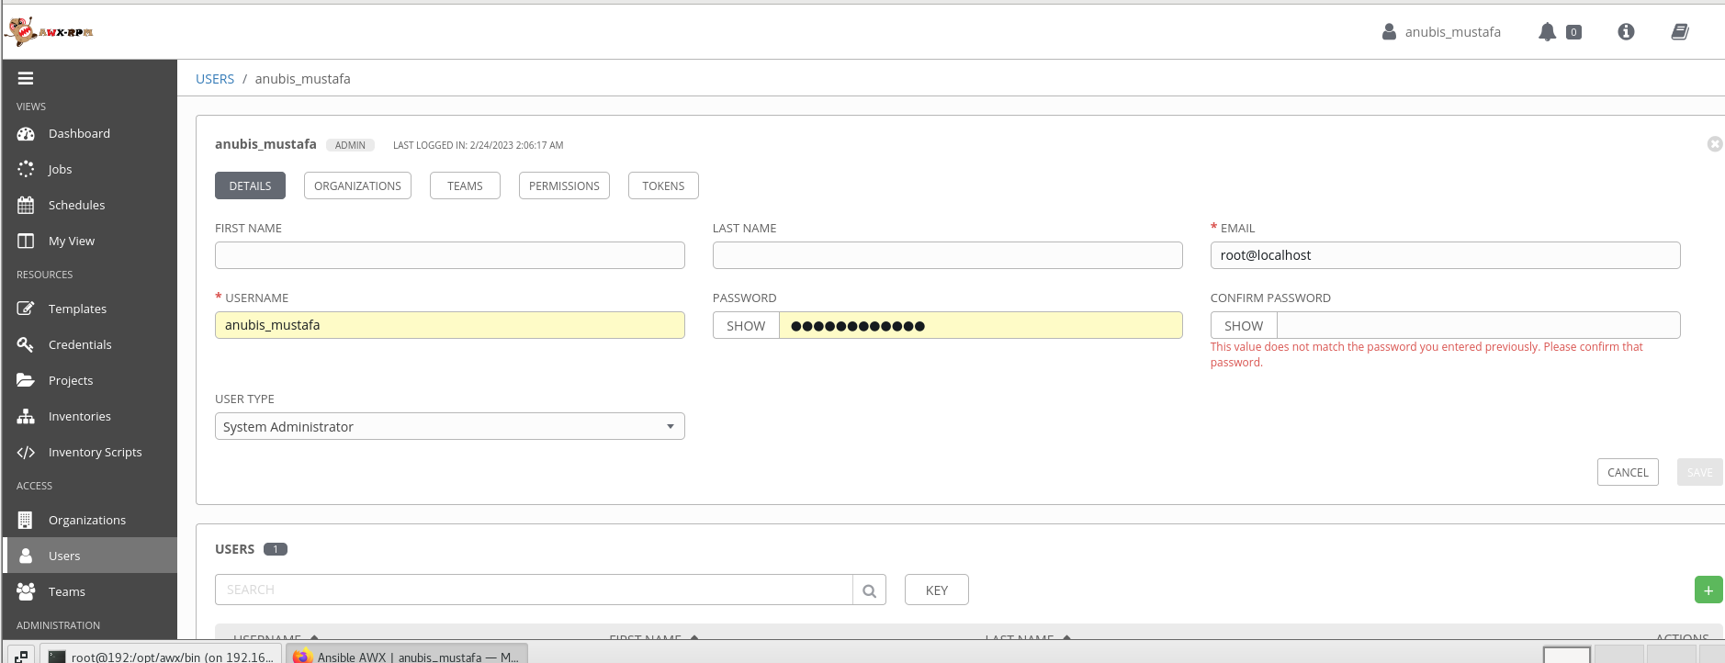
To verify

Slide 29
Demo

